Slide 1

Supervised Learning Algorithms
Agenda
Introduction to Classification
Overview of Logistic Regression
Mathematical Foundation
Model Performance Evaluation

Slide 2
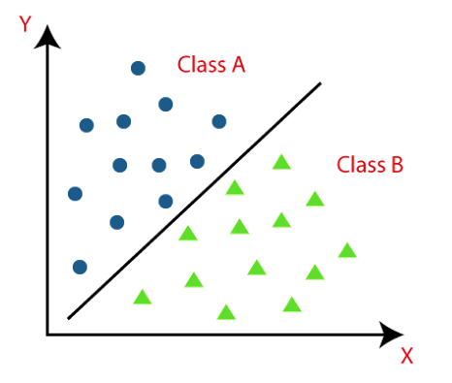
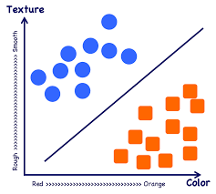
Introduction to Classification

Slide 3
Understanding Logistic Regression
Definition
Logistic Regression is a supervised learning algorithm used for classification tasks.
It predicts the probability that a given input belongs to a specific class.
The output is a probability score between 0 and 1, which is mapped to class labels (e.g., 0 or 1 for binary classification).

Slide 4
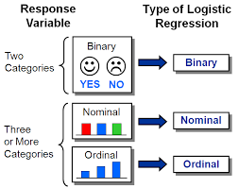
Types of Logistic Regression

Slide 5
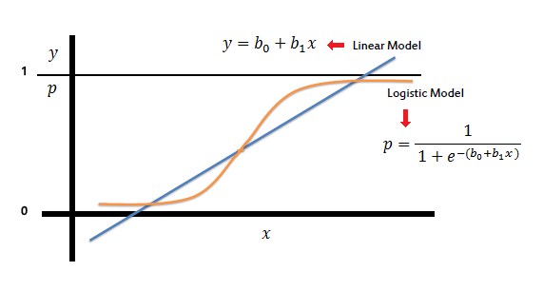
The Sigmoid Function

Slide 6
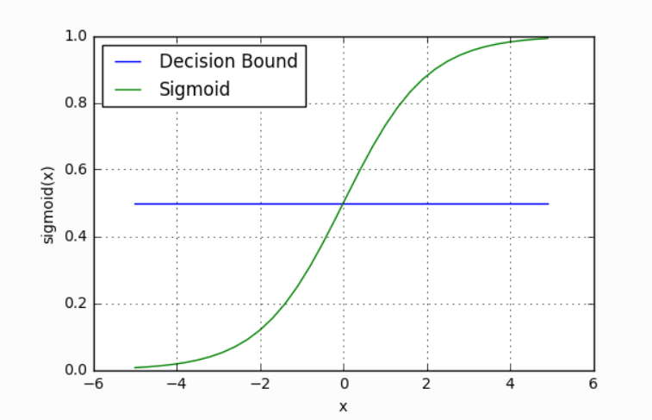
Decision Boundary

Slide 7

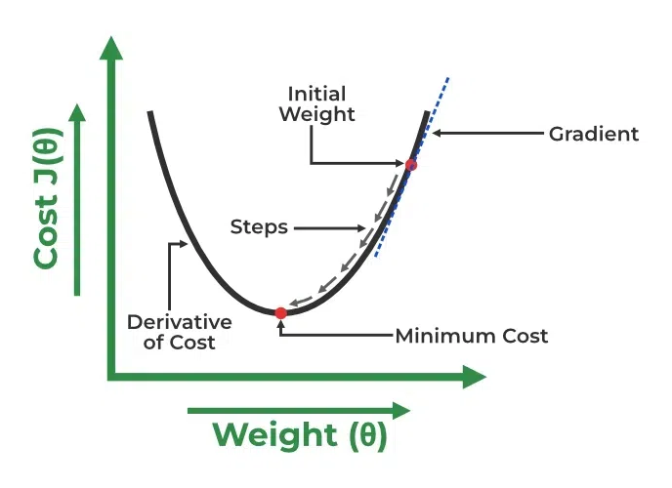
Cost Function in Logistic Regression

Slide 8
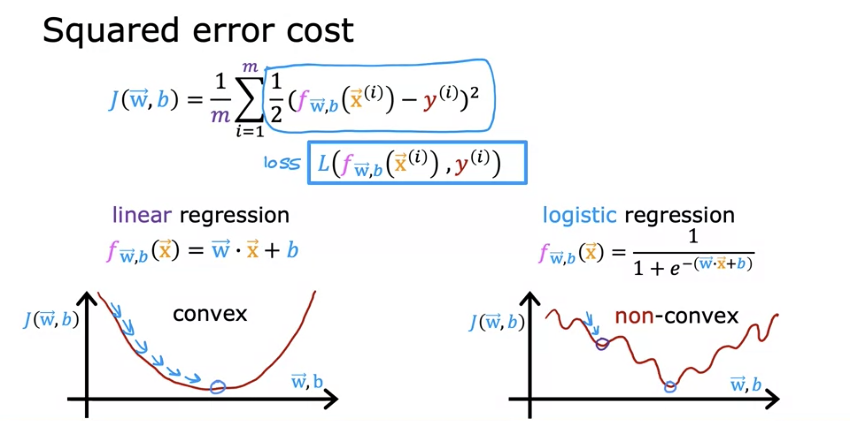
Optimization using Gradient Descent

Slide 9
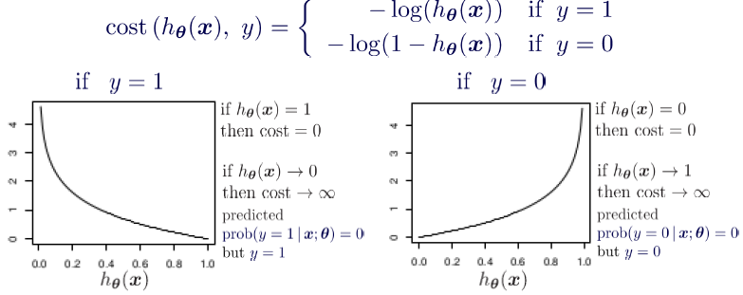
Optimization using Gradient Descent

Slide 10
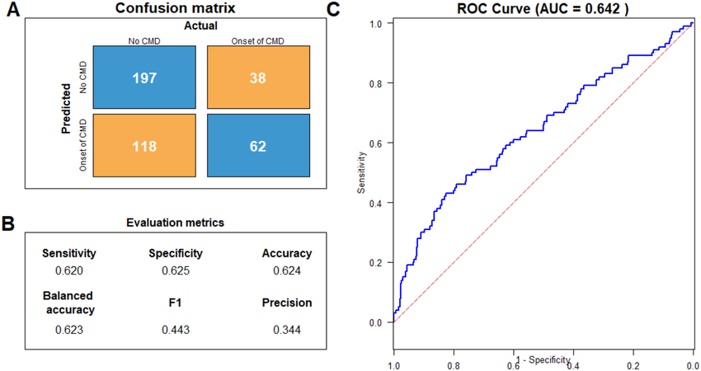
Model Evaluation Metrics

Slide 11
Thank You

